Slide 1
MTSS Overview
Multi-Tiered System of Supports
Notes:
(Denise/Steph)
This is designed to give the staff a rationale for implementing MTSS, a brief understanding of where their district is in the process, giving them some information on what MTSS is, and begin the process of building a common language around MTSS.

Slide 2
Objectives for Today
Understand the rationale for having a MTSS Framework in KCKPS.
Understand the basic overview of MTSS in KCKPS.
Understand the Instructional Focus for 2021-2022

Slide 3
Notes:
Please read KCKPS’s vision/mission and goals. This is what drives our day to day interactions with students. We are all working very hard every day to provide a quality learning experience for every students every day. We care about our students and we want them to succeed and have productive lives. And not just most students, but EVERY student. When we think about “why” our district had made a decision to commit to the MTSS process, this is the why. This is our purpose, this is our identity, and we are building the system to make sure that we can accomplish this.

Slide 4
Rationale Statement for MTSS
KCKPS will implement a Multi-Tier Systems of Support (MTSS) Framework that will…
Provide a clear, coherent, and consistent student focus that ensures alignment across the district.
Support the system with focusing on a limited number of priorities and set up evaluation measures to help eliminate initiatives and programs that are not positively impacting student achievement.
Increase our students’ reading and math achievement at ALL levels.
Establish consistent behavioral and social-emotional supports that assist the whole child.
Notes:
As we begin to put the necessary pieces in place to structure our MTSS framework, we must remember that the implementation of creating the Kansas MTSS is neither a quick fix nor the adoption of new rhetoric. It is a thoughtful and intentional redesign of educational practices and support provided by general education and entitlement programs such as Title I, ESOL, and special education to ensure the needs of all students are being met in the most effective and efficient way possible.

Slide 5
Scaling Up Brief - Fixsen, Blasé, Horner, Sims, and Sugai (2013)
Kansas MTSS and Alignment Implementation Phases
Exploration and Application
Structuring
Implementation
Sustainability
Notes:
Implementation science integrates the multistage approach to change. The progression of the implementation process is captured by the stages of implementation identified as: (1) exploration and adoption, (2) program installation, (3) initial implementation, and (4) full implementation. Rather than being a linear process, the stages are assumed to interact and impact one another in complex ways (e.g., after years of full implementation, the exploration stage may be revisited after a major change in leadership or system supports).
Click: In Kansas MTSS, our phases are titled slightly differently, but have the same basic purpose: to create a slower, more deliberate and deliberated process to guide implementation of researched and evidence based practices.
What we are saying is that MTSS is a process. It takes time and planning to make sure implementation is as successful as it can be. The whole process can take anywhere from 3-5 years. Therefore, we will work carefully as a district to plan and implement accordingly so that we can effectively sustain what’s put in place.

Slide 6
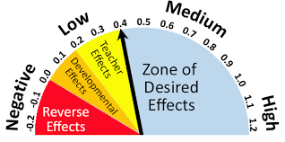
Effect Size Meta-Analysis
Adapted from ACS Education Development, 2016
Notes:
When we move into the work of MTSS, we look at the framework in relation to John Hattie’s research and Visible Learning. Discuss Hattie’s “hinge point” and how it can be used to start discussions among teams as to what instructional practices have the most impact and what practices they want to put resources, PD, and time behind.
We want to do as many instructional practices from the “Zone of Desired Effects” as possible, and replace practices in the Negative, Low, and Medium range when possible.
Any factor greater than .4 has an even greater positive effect on student learning. So, where does MTSS fall withing Hattie’s Zone of Desired Effects?

Slide 7
Effectiveness of a Tiered System of Supports
1.07 Effect Size (0.40 = hinge point)
Improved Outcomes:
Decreased expulsion, behavior referrals, suspension rates
Sustained academic improvement
Increase in on-time graduation
Positive effects on system:
Increased instructional and planning time
More efficient use of resources
Decreased inappropriate special education referrals
Reduced student time in special education services
Reduction in student retention
Burns, Appleton, & Stehouer 2005; Dexter, Hughes, & Farmer 2008; Simmons, Coyne, Kwok, McDonagh, Ham, & Kame’enui 2008; Hattie 2015

Slide 8
“Every student deserves a great teacher, not by chance, but by design.”
(Fisher, Frey, Hattie, 2016)
Notes:
When we think about your mission, we think about this quote. (allow time for participants to reflect on the quote). We said we wanted EACH student prepared for careers and that we wanted to be sure that every student and every level is on track. This is what we’re hoping to build and this is why our district decided to partner with KS MTSS. How do we make sure every student has this great teacher and it’s not up to chance? How do we make sure each student is on track and on time for success at every level? We design a system to ensure it happens. The KS MTSS project is actually funded through Part B funds (discretionary) from IDEA and ESSA for at-risk students. Therefore, KS MTSS is charged with working with school districts to providing students, who are most at-risk, with evidence-based instruction and curriculum. Equity is a legal requirement and an expectation. We do this through a systems-based approach - doing what we know works best for ALL students.
That’s why the KS MTSS and Alignments team has spent a lot of time with the district leaders finding out about what is in place, what the barriers are to implementing this system, and how we can focus and align what is happening in the district so you’re all headed in the same direction, focusing on the same things, with the support you need. Another way of saying what we’re doing is that we’re building a school system (School District) instead of a system of schools (District OF Schools), which is traditionally what we have seen in districts. Everyone trying to do their own thing to try to meet the needs of all students, but now we are doing it together – AS A DISTRICT.

Slide 9
MTSS Myth #1
Myth #1-
MTSS is about intervention.
MTSS emphasizes that a strong Tier 1 (core) is the foundational curriculum and instruction for all students and is the opportunity to have the largest impact of student achievement.
Notes:
Before we start talking about what MTSS actually is, let’s talk about some of the misunderstandings that we often hear about KS MTSS. Let’s start with dispelling some myths about MTSS. A lot of people think they are “doing” MTSS and they may have some of the pieces in place within their buildings. Notice that we are intentional about putting the word “Kansas” in front of the term “MTSS”. That’s because this is the model that was developed for Kansas specifically, based on the research the KS MTSS project has done about what it takes to build and implement true systems change and how to meet the needs of all students.
One myth we often hear is that MTSS is about putting interventions in place. Many schools begin this process thinking they are going to start identifying students who need interventions. While interventions are certainly important and we do help structure schools to support interventions for struggling learners, (click) MTSS does emphasize first and foremost, a strong Tier 1 in terms of curriculum and instruction. An effective MTSS model must address the foundational curriculum and instruction that ALL students need and should get. This is where we know we can have the largest impact on student achievement. We usually say that you can’t intervene our way out of ineffective core instruction and if you have a large percentage of students not being successful with Tier 1 (core) curriculum and instruction, KS MTSS recommends that districts focus on and strengthen their core. Oftentimes, students are struggling because they missed skills in core, not necessarily because they have a disability.
In a few minutes, we will discuss the district’s focus on Quality Tier 1 instruction for the 21-22 school year.

Slide 10
MTSS Myth #2
Myth #2-
MTSS is for General Education students and Spec. Education functions in parallel to that.
MTSS is a systems change. It is intended to meet the needs of all learners, including students with disabilities. All students should receive Tier 1 supports.
Notes:
As the KS MTSS team works with districts, they sometimes hear this myth as districts build protocols and assessment plans. They often build one set of plans for gen. Ed. and assume that special education is not part of that and they will be continuing on with their own thing. This is an issue with the way schools traditionally operate in silos. (click) Since MTSS is a systems change, the plans and structures are designed to meet the needs of all students, including students with disabilities. You will see that, as a reminder, all students should receive Tier 1 curriculum and instruction so that all students can access the general curriculum.

Slide 11
MTSS Myth #3
Myth #3-
MTSS is “just one more thing” we have to do.
MTSS is not a program, but an overarching framework for academic and behavioral instruction. It is a logical way of doing business for meeting the needs of all students with the limited resources that districts have.
Notes:
MTSS is not a program, it is not a curriculum. Those things do not alter the structure of the school. (click) MTSS is a framework for academic and behavior instruction. It is a framework that will help the district accomplish your KESA (district accreditation) and Strategic Plan goals and the requirements set out by the Dyslexia Task force.
It is a new way of doing business to meet the needs of all of our students. Remember, the implementation of creating the Kansas MTSS is neither a quick fix nor the adoption of new rhetoric. It is a thoughtful and intentional redesign of educational practices and support provided by general education and other district programs such as Title I, ESOL, and special education to ensure the needs of all students are being met in the most effective and efficient way possible.

Slide 12
MTSS Myth #4
Myth #4-
MTSS gets rid of the Spec. Education referral process.
At any time, the collaborative team suspects that a student may have an exceptionality and/or a need for special education services, the team must refer the student for an initial evaluation.
Notes:
Another myth is that MTSS will get rid of the Sped referral process. That is a myth. Kansas MTSS should, however, get rid of inappropriate special education referrals because we will have a system by which we will have supports and interventions in place and pre-determined for students who have skill gaps. Special Education is often the only place students can get additional support in schools so many times, students are inappropriately referred in order for them to get additional instruction.
However, the Kansas MTSS process should not delay a student from receiving a special education evaluation, and parents must be informed of the nature of student performance data being collected, the general education services being provided, strategies for increasing the student’s rate of learning, and their right to request an evaluation. You will, however, have a system of collaborative teams looking at data regularly and determining what is working and not working and adjusting instruction accordingly. That data can be used if you suspect a student needs a referral for special education.

Slide 13
MTSS Myth #5
Myth #5-
Students in Tier 3 are in Spec. Education.
Some students in Tier 3 may be in Spec. Education and others may not.
Students are provided support based on their need, not their label.
Notes:
This is another myth…not all Sped students are in Tier 3. You may have students who need Spec. Education services in Tiers 1, 2, or 3. Tier 3 is the most intense level of intervention provided to students in general education. A student who does not respond to these intense interventions MAY qualify for special education services when it has been demonstrated that either the intensity or type of intervention required to improve student performance either exceeds the resources in general education or are not available in general education settings.
Tier 3 is INTENSIVE INSTRUCTION and is not defined exclusively as special education. Basically, all students go into the system and they are given support based on what their data says they need, not their label of Spec. Education, Title students, General Education, etc.

Slide 14
MTSS Myth #6
Myth #6-
MTSS is for struggling students only.
KS MTSS is a systemic approach that supports both struggling and advanced learners through the selection and implementation of increasingly intense evidence-based interventions in response to both academic and behavioral needs.
Notes:
We have heard terminology such as “put him on the MTSS schedule” or “MTSS’ing a kid”. KS MTSS is for ALL students. That implies that MTSS is only for students who are struggling. (click) In reality, MTSS is, as you may remember, a systemic approach for providing a continuum of supports for all students from those who struggle to more advanced learners.

Slide 15
What is Kansas MTSS?
A coherent continuum of evidence based, system-wide practices to support a rapid response to academic, behavioral and social emotional needs with frequent data-based monitoring for instructional decision making to empower each Kansas student to achieve high standards.
Notes:
So what IS Kansas MTSS? Here is the KS MTSS definition. Take a moment to read it to yourself. Then turn to the person next to you and talk about which phrases stand out to you and why. (pause)

Slide 16
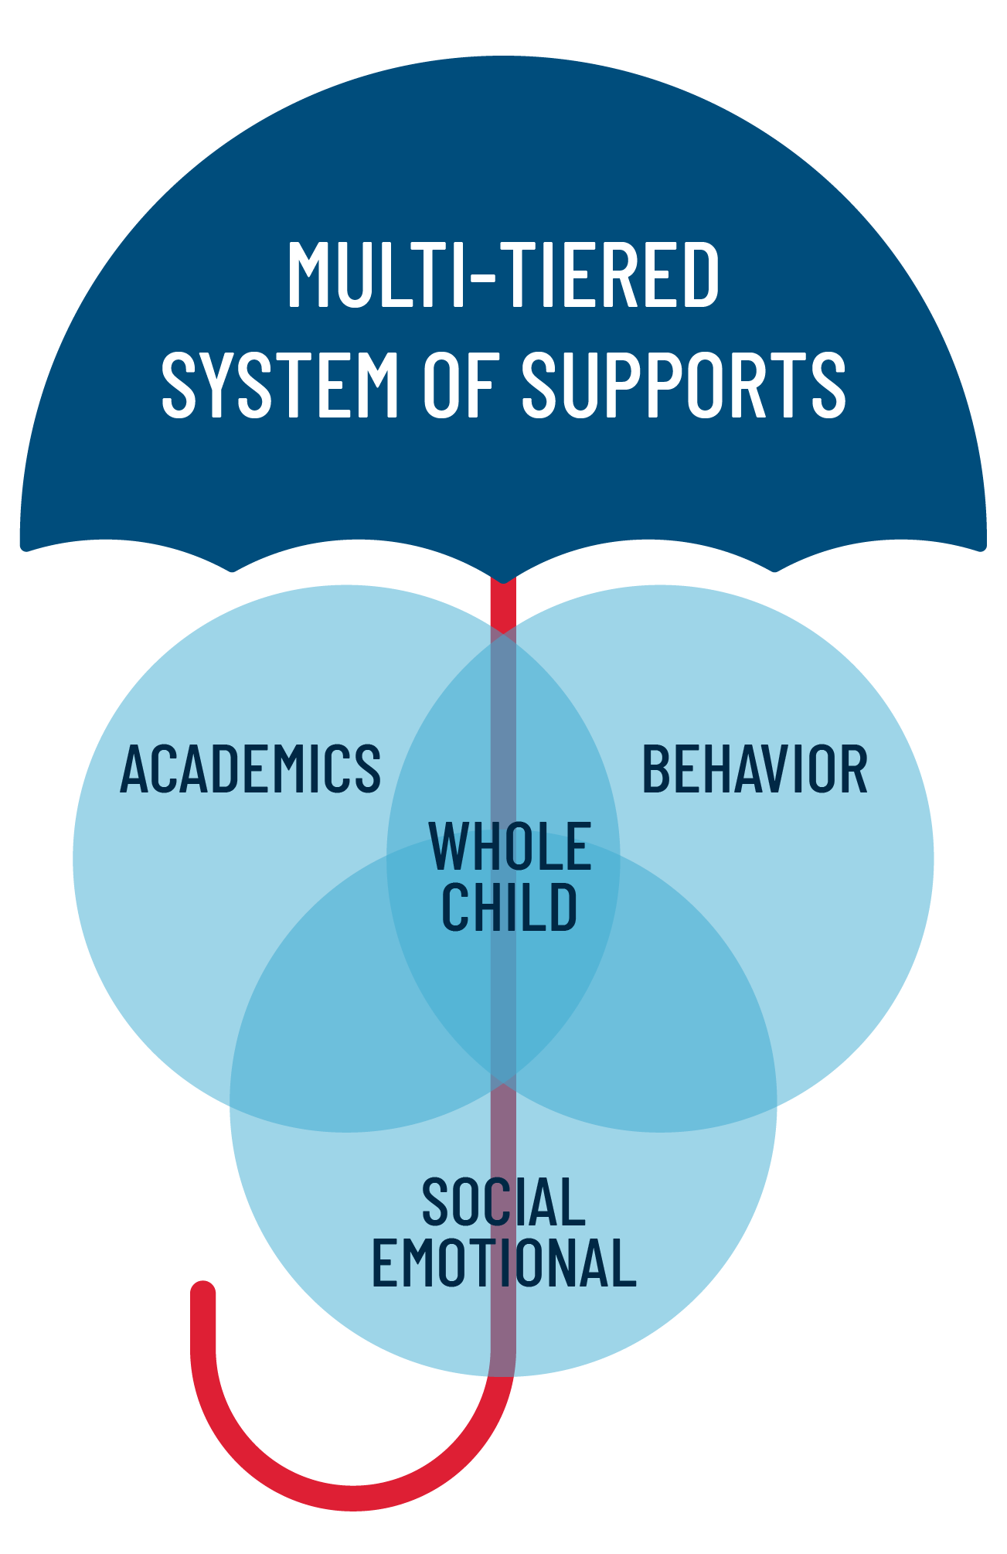
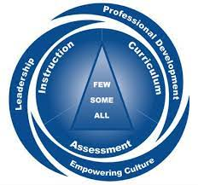
Instructional Focus for 2021-2022
Behavioral and Social Emotional Learning (BSEL)
Behavioral and Social Emotional Learning Embedded Throughout the Day and Year
Trauma-Sensitive and Resilient Schools
Use of District Provided Social-emotional Curriculum Resources
Culturally Relevant, Inclusive, and Sustaining Practices
Curriculum, Instruction, and Assessment
Continued Focus on Quality Tier 1 Instruction
Focused Model of Instruction w/ SIOP and Co-Teaching Alignments
Use of District Provided GVCs and Resources
Culturally Relevant, Inclusive, and Sustaining Practices
Literacy
Science of Reading and Structured Literacy
Implement a District Comprehensive Assessment and Data Plan
Analyze Assessment Data to make Data-Driven Decisions
Notes:
So, as we dispel the common myths of MTSS across the system and implement a true MTSS framework, the district has collaborated with the KS MTSS team to establish the following instructional focus for the 21-22 school year.
Umbrella Graphic--Again...MTSS is not a program, but an overarching framework (umbrella) for academic, behavioral, and social-emotional learning. It is a logical way of doing business form meeting the needs of all students with the limited resources that districts have. As KCKPS implements a Multi-Tier Systems of Support (MTSS) Framework, we must remember that this is the umbrella for all of the work that we will do as it relates to Academics, Behavior, and Social-emotional learning, which at the heart of all that work is the “whole child”.
KS MTSS Graphic-- The following is the KS MTSS and Alignment Framework. In the center of the graphic, you see a triangle that represents tiered levels: All being Tier 1- This means ALL students have access to quality, rigorous curriculum and instruction no matter if they are ESOL or SpEd.; Some being Tier 2; and Few being Tier 3. As a district we will focus on making sure we have high quality curriculum and instruction in every classroom and for every student.
Therefore, in Academics we will focus on the following areas in Curriculum, Instruction and Assessment (REFER TO THE BULLETS IN THE CIA SECTION---HELP STAFF REALIZE THAT MANY OF THESE FOCUS AREAS ARE A CONTINUATION OF PRIORITES FROM LAST YEAR AND PRIOR TO THAT-PRE-PANDEMIC)
Quality Tier 1 Instruction
Continue to utilize and implement our MOI (evidence-based/research-based instr. Practices) with alignments to the work of SIOP and Co-Teaching (not separate things…embedded);
Ensuring usage of the GVCs and Curr. Resources- we can’t measure success of the resources if everyone is using different things with our students
Must ensure our curriculum and instructional practices match the beautiful and diverse students we have in our district
Literacy
- Continue to develop our understanding and implementation of the science of reading and structured literacy and how students learn to read (Aligns with KSDE dyslexia initiative, LETRS training (coming soon), adoption process for a new K-3 reading resource for 22-23.
Implementation of a Comprehensive Assessment Plan
- As a district, we have developed a plan for what assessments we will give at all levels, why we are giving those assessments, when we will give them, and how/when we will review the data that we get from those assessments (discussed later in presentation)
Again, we have to remember that we are focusing on the whole child, so we can’t omit the Behavioral and Social-Emotional Needs of our students
Many students and staff have experienced trauma these past few months and year, therefore, we will continue to focus on the TSRS work started a couple of years ago
Resources-Continue to teach kids the necessary BSEL skills to be successful in and out of the classroom

Slide 17
What do you see here?
Notes:
It’s easy to feel overwhelmed when something new comes along--another initiative, another screener, another strategy, another curriculum, another grant….etc.
So, one more thing MTSS is not is ANOTHER item stacked on your already overloaded car!
This process will also be able to tell you what you will be able to give up.
Basically, we start with having a district pull out everything “in their closets” and they inspect those things and talk about which ones are evidence-based, which ones have research to support them, which ones will make a difference for our students, which ones are “watering down” the effectiveness of those things that really work. Then we put the things we want to keep back on the “shelves” and those shelves are part of our framework.

Slide 18
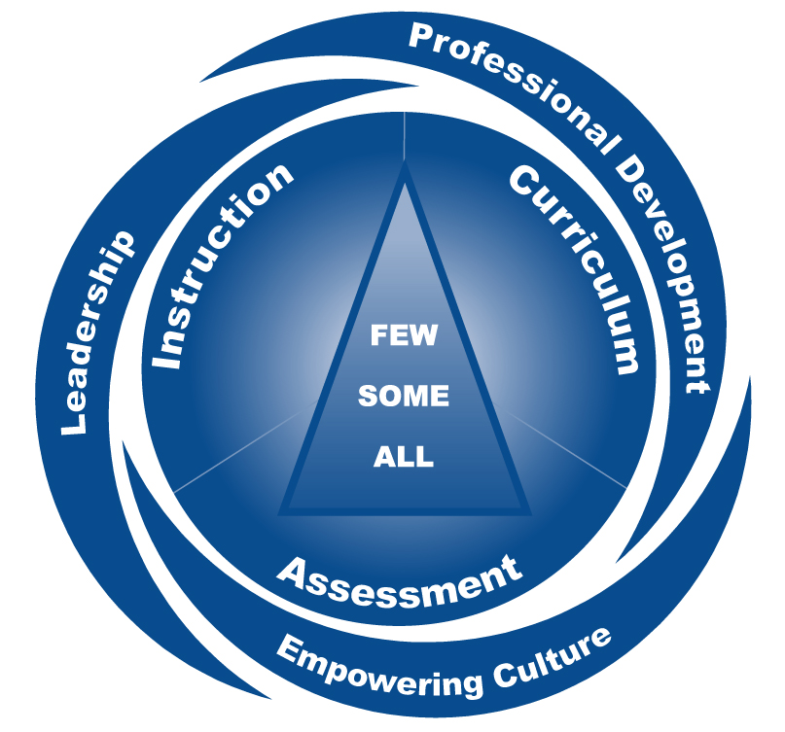
PD Plan
- FASTBRidge
- LETRS
- Use of data
DILT
BLTs
Formal communication
Model of Instruction
Evidence based instructional practices
Schedules**
Curriculum adoption
Intervention materials**
GVC
Protocols**
FASTBridge
Comprehensive Assessment Plan
PLCs involved with school improvement
Partnership with families
Vision/Mission/Goals
Notes:
Here is the graphic that represents the main components of KS MTSS. You may have seen this graphic before. We refer to it as our “hurricane”. When we talk about KS MTSS, many times our minds go to what we see in the middle of the hurricane, which is the triangle of all, some, few. However, MTSS is more that just the ALL, Some, and Few. Within the the KS MTSS Framework some of the initiatives and areas of work KCKPS are already invested in. MTSS is simply a framework to organize and synchronize that work into a cohort system, rather than random acts of educational reform.
Next, we’re going to spend some time looking at some of these areas of the hurricane through the lens of KCK work.
At the center of the hurricane is the triangle you are all familiar with and represents our students. There are some things that ALL students need, some things SOME students need and some intense supports only a FEW should need.
In a similar manner, there are some things that ALL schools will be involved with developing this year. ALL schools will be: doing a curriculum adoption, implementing BLTs and PLCs, reviewing GVCs, administering FASTBridge. All buildings will at least be looking at data from a global level - Group Screening Report.
**Things that the district is working on to be ready for to fully implement in the 22-23 school year.

Slide 19
PD Plan
- FASTBRidge
- LETRS
- Use of data
DILT
BLTs
Formal communication
Model of Instruction
Evidence based instructional practices
Schedules**
Curriculum adoption
Intervention materials**
GVC
Protocols**
FASTBridge
Comprehensive Assessment Plan
PLCs involved with school improvement
Partnership with families
Vision/Mission/Goals
Notes:
Let’s start with Assessments.
All schools will be giving FASTBridge SCREENING assessments to all students. While there is a myriad of subtests you can choose, the assessments we will be using will be narrowed down for you at the district level, so when you are ready to give your screeners, only those subtests we need for data-based decision making will populate for you! You also have to have these screeners are part of meeting dyslexia requirements.

Slide 20
The purpose of screening is to
identify who is predicted to be in trouble, but it doesn’t tell you what to teach.
Notes:
If I go to the doctor today, what do I know he will do?
MTSS assists schools in following a medical model--we screen for possible risk, may not tell us WHAT is wrong, but gives us an indication of where we should probably dig a little deeper.
Screeners tell us which students are on track three times a year. Screeners must be quick and easy to administer. Screening that takes too long defeats the purpose of it...we want students to spend less time in assessment and more time in valuable instructional time. (would you let your dr give you every test he has at his fingertips just because it is interesting information?)
The screeners we suggest are timed, so we know if students can perform a skill automatically. (Automaticity tied to the rapid naming skills we look for as part of dyslexia screening)
They are not meant to tell us everything. It tells us which students are at-risk and which may need additional intervention.
A student’s score is compared to a benchmark score - benchmarks are based on collecting data from a large group of students across the country. Based on how well as student does on selected indicators at a certain point, that predicts future reading success.

Slide 21
What is a Universal Screener?
Brief, efficient, FORMATIVE assessment
Given 3 times a year
ALL students
On grade level
Identifies which students are “at-risk” and which are “on track”
Predictive
Systems level data and individual student data
Success of Tier 1 Curriculum and Instruction
Notes:
Medical Model: In MTSS, we often compare our processes to the medical model. This helps give schools an idea of how assessments are best used and the purposes for each assessment. We will start with universal screening…universal screening is similar to what a doctor would do for all patients when they come into the office. There are certain tests that give the doctor an indication of a patient’s overall health. These are things like weight, blood pressure, temperature. It doesn’t tell you what is wrong with the patient, but gives an overall indication of how healthy the person is. Much like in the MTSS process, a universal screening instrument will give us an idea of every student’s overall reading “health.” A misunderstanding we often hear is that teachers don’t like universal screeners because it doesn’t tell them everything they need to know…it is not designed to tell us everything we need to know. It is designed to tell us which students are “healthy” in their reading, or are acquiring the appropriate skills they need to become proficient readers, and which students may need more support to acquire those skills. It is designed to tell us “which” students may need more support and which ones do not…it does not tell us “what” the problem is, if there is one. Overall, how healthy of a reader are you?
Students spend time in instruction, and not assessment. Screening measures with the following characteristics: brief, repeatable, technically adequate, measure critical skills, have empirically derived cut scores, and are easy to administer and score (VanDerHeyden & Tilly, 2010).Get data into the hands of teachers for instructional decision making. DBDM: What is the problem? Why is the problem occuring? What to do about the problem? Did it work?
Students in special education or other populations are not excluded from such screenings. Remind the team of the concept of equity.
Accurately identify students who are at-risk for future academic and/or behavior difficulties, and establish the need for further instructional support of those students. Which students are on track three times a year. They are not designed to tell us everything.
Additionally, these measures have been shown to predict which students are very likely (i.e., 80 to 90 percent certainty) to reach future benchmark goals and/or reach a desired level of performance on outcome measures. This is why our model is able to provide prevention and early intervention.Based on how well a student does on selected indicators at a certain point, that predicts future reading success. WE DO NOT TEACH TO UNIVERSAL SCREENERS. They assess important skills that predict future success, but they are not the only skills that are needed.
Tells us how effective our instruction and curriculum is - if a large percentage of students are not successful with Tier 1 instruction, then we need to look at how well our core is meeting the needs of most of our students. YOU CANNOT INTERVENE YOUR WAY OUT OF A TIER 1 PROBLEM! Give us important information in evaluating Tier 1 instruction and curriculum. “What does “second grade reading instruction look like in your school or district?” They may know how many minutes, but rarely know how that time is being used. Looking at and evaluating Tier 1 instruction and curriculum is long term collaborative work.

Slide 22
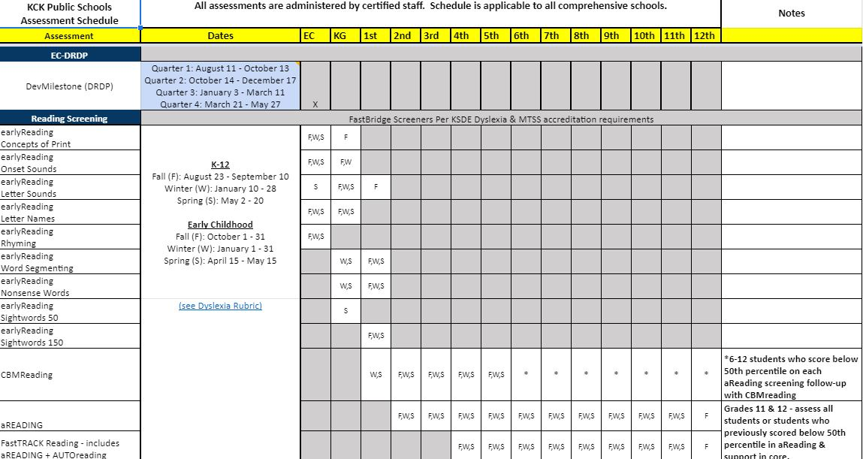
Notes:
As part of the MTSS Work the district has done, we have developed a District Comprehensive Assessment Plan. THE PLAN CAN BE SHARED AFTER THE PRESENTATION WHEN YOU HAVE TEACHERS WORK ON CERTIFICATIONS.
On the first page, you will see the schedule of assessments and when they should be administered.
This fall ALL KCKPS students will be given the FASTBridge assessments assigned to each grade level. Some of these are 1-on-1, others are group administered on the computer. The system has pre-determined benchmark cut scores--these are not “rocket science” level scores. Benchmark simply means you have the bare minimum skills to “get in the game,” that you should be successful with good core instruction and should grow enough to reach the winter benchmarks with core support only. --- STRESS the fact that these are FORMATIVE assessments. State assessments are also included on the plan as they are to be administered by the district.
On the second page of the plan, we have included the purpose of the assessments and why they are given in the district.
The third page is the accountability cadence page which establishes when data should be reviewed and anayzed. This ensures we are aligned as a system on when data should be reviewed. The cadence page also ensure that we as a district are also looking at data in the same way. One building should not be reviewing and analyzing data in a different way than another.
Finally, the fourth page was developed to help staff understand which FastBridge certifications are required for each grade level.

Slide 23
Vision for Assessment and Data in KCKPS
Data is not about ranking - It is about determining our strengths and where to place resources to support areas of growth
Multiple data points to make the best instructional decisions
Continue to experience, learn and implement the FastBridge assessment platform
Accountability for ourselves and our students to ensure they are learning what is taught (Focus- Priority Standards)
Compliance with KSDE and the Federal Government
Notes:
PLEASE HELP YOUR STAFF UNDERSTAND THAT THE DISTRICT IS NOT USING DATA TO RANK SCHOOLS OR TEACHERS. WE ARE USING DATA TO INFORM INSTRUCTION.

Slide 24
PD Plan
- FASTBRidge
- LETRS
- Use of data
DILT
BLTs
Formal communication
Model of Instruction
Evidence based instructional practices
Schedules**
Curriculum adoption
Intervention materials**
GVC
Protocols**
FASTBridge
Comprehensive Assessment Plan
PLCs involved with school improvement
Partnership with families
Vision/Mission/Goals
Notes:
We mentioned that ALL schools will be involved with the core curriculum adoption and reviewing GVCs. Some core curriculum was even piloted this summer and will be piloted this fall!
Later, you will also be taking stock of current curricula used for SOME or a FEW students who fall below benchmark. We will be evaluating those, as well, and some new selections may need to be added. For both the core and interventions, a curriculum protocol will be developed. This is our district “game plan” so we can confidently say what the GVC is for ALL students.
Think about the impact for student mobility issues with a consistent district curriculum! Can you think of other sub-groups for which this will be helpful?

Slide 25
Curriculum and Instruction for Tier 1
(ALL)
Aligned with Standards (PreK-12)
Utilizes evidence-based instructional strategies and practices
Ensures vertical alignment of instruction from:
Grade to Grade
School to School
Notes:
All students are allowed equitable access to core instruction aligned to their grade level standards
Aligned with Kansas Standards and Kansas Early Learning Standards (preschool)
Research-based curriculum materials used to teach core skills, strategies, and knowledge
Evidence-based instructional strategies:
Explicit and systematic instruction
Ample opportunities for practice
Scaffolding
Differentiated instruction
Provide vertical alignment of instruction from grade to grade and school to school
Ensure continuity of routines and vocabulary for students across grades and buildings
Give staff common ground for communication regarding instruction, professional development and goals for students
Are delivered with fidelity in order to obtain desired outcomes

Slide 26
PD Plan
- FASTBRidge
- LETRS
- Use of data
DILT
BLTs
Formal communication
Model of Instruction
Evidence based instructional practices
Schedules**
Curriculum adoption
Intervention materials**
GVC
Protocols**
FASTBridge
Comprehensive Assessment Plan
PLCs involved with school improvement
Partnership with families
Vision/Mission/Goals
Notes:
Now, let’s talk about instruction….curriculum is the WHAT, instruction is the HOW. We want to insure we are using those instructional practices that are “game changers,” or “high leverage practices.” (Remember Hattie’s hinge point at the beginning?)
Eventually, we will be identifying a small number of those instructional practices we believe would move the needle for KCKPS students and will invest in getting those installed as “just how we do business at KCKPS.” These practices should not been seen as separate from our MOI. Hattie’s instructional practices can be aligned to the overarching strategies in out MOI. As we plan our next steps with our MTSS work, we will also be refining schedules to ensure that there is adequate time for both core and intervention (22-23 school year).

Slide 27
Notes:
ADDED TO SHOW ALIGNMENT OF SIOP TO MOI

Slide 28
PD Plan
- FASTBRidge
- LETRS
- Use of data
DILT
BLTs
Formal communication
Model of Instruction
Evidence based instructional practices
Schedules**
Curriculum adoption
Intervention materials**
GVC
Protocols**
FASTBridge
Comprehensive Assessment Plan
PLCs involved with school improvement
Partnership with families
Vision/Mission/Goals
Notes:
Now, let’s focus on the outer sections of the KS MTSS Framework. The outer parts of the hurricane are those system level pieces that are easy to put to the side, but are the “glue” that holds all of your good work together! Let’s start with leadership. Leaders are found at the district, school, and even grade level.

Slide 29
Every leader at every level is responsible for every student.
Notes:
One of MTSS’ core beliefs is that “every leader at every level is responsible for every student.” Stop and talk to your shoulder partner: what does this statement mean to you? What does it NOT mean?
If every one of us is responsible for the success of every student, we have to have strong communication. That means that DILTs and BLTs and collaborative/PLC teams need to regularly communicate what is happening with students--our successes, as well as our challenges.
This kind of strong communication requires a formal process to ensure that the voices representing ALL students are heard!

Slide 30
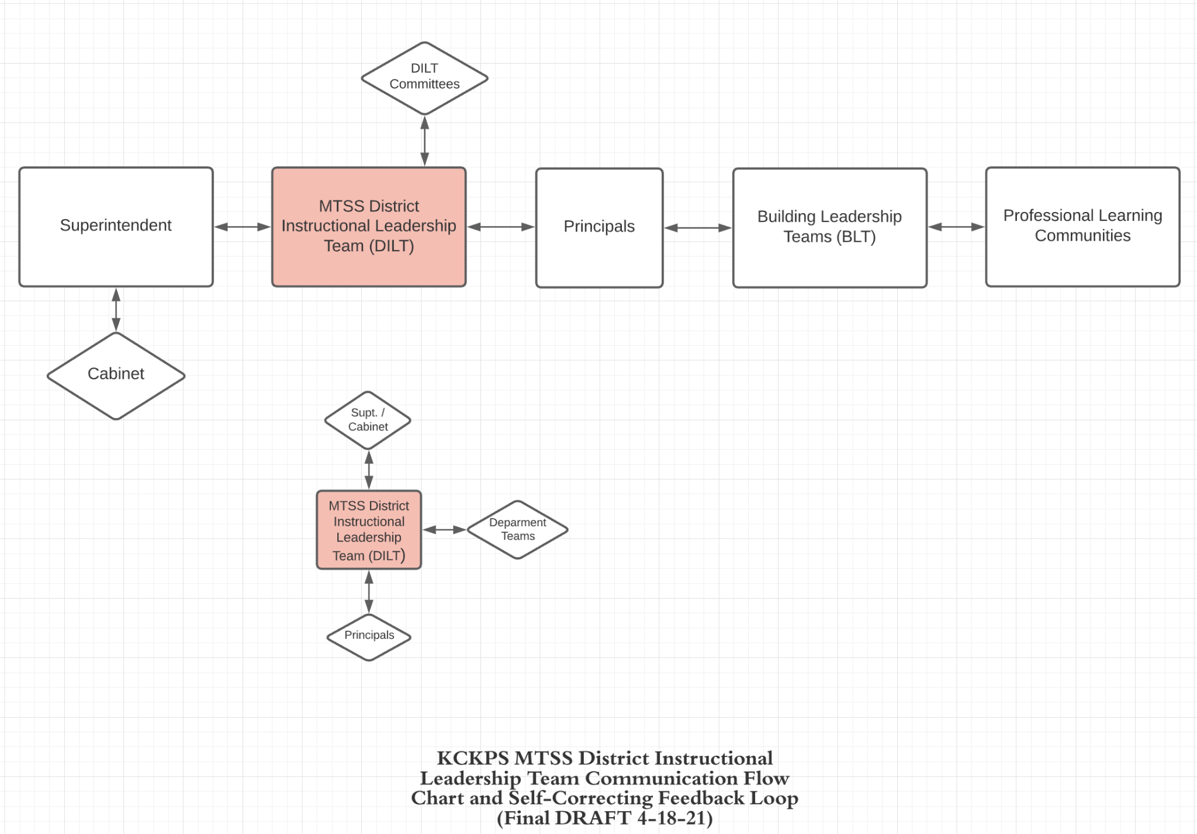
Notes:
Here is our DRAFT Communication Flowchart and Self-Correcting Feedback Loop. This was developed in partnership with the KS MTSS Team to ensure the district has clear and effective communication, which is key to the success of any school district. Right now, this will be the avenue for communicating throughout the district and also for getting feedback.
Smaller graphic – Inner Communication within Central Office and District Departments
Larger Graphic – Communication across the system. Communication isn’t a one-way street…it is two-way. Therefore, communication will come from the district but the district needs to get information back to help know what’s working and what’s not. Data will be used to help us make that determination. The improvement of a school system is dependent on creating collective expertise among all these loops. These different teams work together to analyze evidence of effectiveness, identify student needs, and select evidence-based strategies and practices to improve student learning.
IF TIME PERMITS…
Key components of the Self-Correcting Feedback Loop (SCFL) and WHY we, Kansas MTSS, emphasize it:
The defining element of an effective MTSS is a self-correcting feedback loop.
A self-correcting feedback loop is achieved through the use of a problem-solving process that continually collects data, analyzes results, and makes adjustments aimed at positively influencing student learning and achievement.
Best case is to have all three functioning – MUST have instruction & building system functioning
Also point out to teams that the problem solving process (look, think, act) is embedded within the SCFL.

Slide 31
PD Plan
- FASTBRidge
- LETRS
- Use of data
DILT
BLTs
Formal communication
Model of Instruction
Evidence based instructional practices
Schedules**
Curriculum adoption
Intervention materials**
GVC
Protocols**
FASTBridge
Comprehensive Assessment Plan
PLCs involved with school improvement
Partnership with families
Vision/Mission/Goals
Notes:
If we want to build for success, we have to ensure people are getting the professional development they need to be successful with each of these pieces of the framework. Part of this year’s PD will include giving FAST, opportunities to participate in LETRS (EC-5 ONLY), and how to use data to make decisions, not just collect it.
This year, teachers will need training in FAST. Step one is simply giving teachers the time to learn HOW to give the assessments they will be responsible for. That PD is available online. DO NOT WORRY about trying to figure out which reports to use to interpret. The goal this fall is to get the right assessment given to the right students in the right way! PD will be provided later on how to interpret and use that data.
Once the new core curriculum is selected, PD will need to be provided in how to use it well.

Slide 32
Language Essentials for Teachers of Reading and Spelling (EC-5 Only)
Notes:
IF NOT EC-5 (DELETE)
As part of the state’s use of ESSR money, this deep reading knowledge will be available to some teachers across the state--KCK teachers are part of that first group with an opportunity to be part of this!
LETRS is not reading strategies or a curriculum--written by Drs. Louisa Moat and Carol Tolman, LETRS provides teachers with the research, depth of knowledge, and skills to make a significant improvement in the literacy and language development of every student. Note: LETRS for Early Childhood is written by Drs. Louisa Moat and Lucy Hart Paulson

Slide 33
PD Plan
- FASTBRidge
- LETRS
- Use of data
DILT
BLTs
Formal communication
Model of Instruction
Evidence based instructional practices
Schedules**
Curriculum adoption
Intervention materials**
GVC
Protocols**
FASTBridge
Comprehensive Assessment Plan
PLCs involved with school improvement
Partnership with families
Vision/Mission/Goals
Notes:
Finally, let’s look at empowering culture. Building an MTSS well in and of itself begins to develop that empowering culture within a district. We begin to have collective efficacy, which has one of the highest effect sizes Hattie has studied!
Part of this year’s work in creating that culture is working with PLCs as an avenue for improvement, not just at the student or classroom level, but also at the school and district level. We always need to keep family partnerships in mind--how do we engage families in the work we are doing?

Slide 34
Kansas MTSS and Alignment
Tier 3
Tier 2
Tier 1
Notes:
An empowering culture runs on strong data. PLC conversations become data-focused.
A data-driven framework that can be used to
Monitor the overall level of risk and progress in the school as a whole
Identify students who may require additional supports in academic, behavioral, and social domains
The goal is to have 80% of students at benchmark. This is what we can expect when Tier 1 is effective. Below 80% at Tier 1, we would want to look at core (both programs and instruction/fidelity).
Tier 2—15%
Tier 3—5%
Ask: Where do you see students in special education within this triangle? (They are throughout--Tier 3 does NOT equal sp. education)
Use this slide to think about what all schools will be using/doing with MTSS - the core curriculum and what all kids are getting. The data you will be looking at is how successful is your core by using FASTBridge’s Group Screening Report.

Slide 35
Act
Look
Think
Notes:
Part of the work of an empowering culture is to create impact cycles. In educational world, we tend to do a lot of looking and acting.
Name some actions you could take for a kid that does not do homework?
(Tell Claire Overstake’s story of her middle school student who did not do homework--running drugs with foreign bank accounts, plan to “retire” at 18).
If we don’t take the half step back to think, and simply act, or rather RE-act, our responses to student and system level needs may not address the real issue.

Slide 36
Notes:
By establishing and implementing a district-wide MTSS Framework, KCKPS is well on the way to Reaching our Vision, Mission, and Goal!

