Slide 1
SPRING 2017 ELL student English Proficiency Exam (K-ELPA)
KITE CLIENT/
Student Testing Interface
Presentation Template for Building Training
David Rand, Director DERA

Slide 2
Welcome to KITE
The KITE Client is a program that students use to take the computerized state assessment and prohibits students from accessing other programs while testing
The KITE Client is available for Windows, Macintosh, iPad and Chromebook
***NOTE – Please contact DERA first for any KITE related issues; if we cannot troubleshoot the problem, we will then refer you to the KITE Help Desk
  Dr. Doug Hager – 913-932-6707 (Wyandotte & Schlagle Clusters, Bridges)
  Samantha Bradshaw – 913-575-3261 (Harmon & Washington Clusters, Sumner, JDC)
KITE Help Desk Support
  Phone: 785-864-3537
  Email: kite-support@ku.edu
The KITE Educator Guide for the student experience provides a Quick Start Guide that has step-by-step directions for accessing the system as well as a detailed list of all Tools within KITE that are available for student use

Slide 3
Computer Readiness
As much as possible, testing should be conducted using mobile technology deployed to schools (iPads, Chromebooks and MAC laptops)
Latest version of KITE has been deployed to mobile technology and MAC labs; PC labs may not be updated with latest version of KITE and applicable web browser
If necessary, KITE app can be downloaded from self-service or the iTunes store for MAC machines and iPad; all Chromebooks should have the KITE app installed
  *Students do not log-in to Chromebook to access KITE; it is launched from the ‘Apps’ tray
All machines to be used must be checked to ensure latest version of KITE – launching either general KITE practice test or K-ELPA practice test successfully verifies computer readiness
Schools need to ensure that students have access to headphones with microphones for the Speaking assessment
  Speaking cannot be administered on iPads; schools should use the Chromebooks to administer the Speaking portion for students that would normally test on an iPad

Slide 4
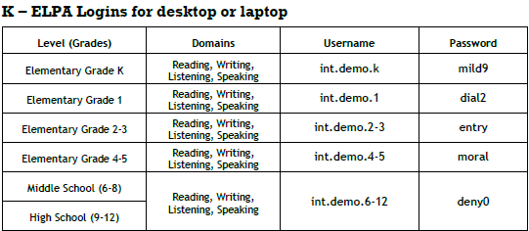
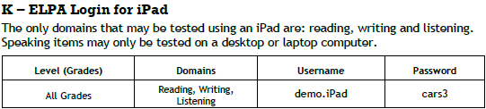
KITE Practice Tests
KITE has practice tests available for K-ELPA so that students may have practice navigating through a test and using the available tools
These practice tests are intended to be used for practice on the testing interface; they are NOT meant for content review or to represent actual test content
Practice test log-ins for K-ELPA KITE assessment (click here for enlarged print)

Slide 5
Quick Start Guide
Quick Start Guide is for staff that will be assisting students in logging-in to test and test navigation and includes step-by-step directions for:
  Starting/Running KITE Client
  Logging In
  Starting a Test
  Navigating through KITE
  Ending a Test

Slide 6
Quick Start Guide
Step 1 (Macintosh or Windows) – Launch KITE Client by double-clicking on the KITE icon on the computer desktop

Slide 7
Quick Start Guide
Step 1 (iPad) – Tap KITE icon and then tap ‘Get Started’

Slide 8
Quick Start Guide
Logging In
Step 2 - Enter user name and password, then click ‘Sign In’
  Students use same user name and password for all subject areas and test parts (student log-in information printed and distributed to schools by DERA)

Slide 9
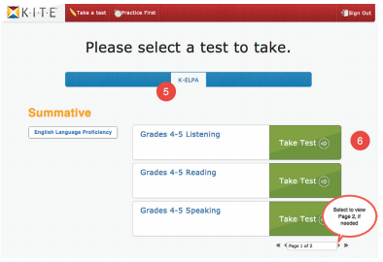
Quick Start Guide
Starting a Test
Step 3 - Click ‘Take a Test’; on following screen, click ‘Take Test’ next to appropriate test

Slide 10
Quick Start Guide
Starting a Test
Step 4 - Enter the appropriate ‘Daily Access Code’ for the scheduled domain being tested
  ***Schools will be provided daily codes in advance of testing***

Slide 11
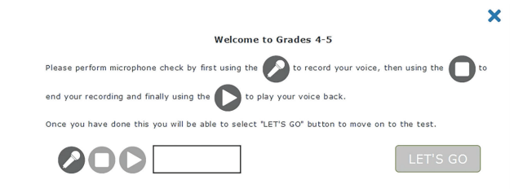
Quick Start Guide
Sound and Recording Check - Listening
For the Listening domain only, students will be prompted to test the sound and recording volumes and should follow directions on screen

Slide 12
Quick Start Guide
Starting a Test
Step 5 – Students read test directions and click ‘Begin’/‘Next’
  *NOTE – Test directions can be accessed at any time by navigating to the 1st question and clicking ‘Go Back’ and are separate from teacher script in the Examiner’s Manual

Slide 13
Quick Start Guide
Navigating Through KITE
This is an example of the main test window
Navigation Bar at top of screen used to jump directly to a question
Toolbox on left side of screen provides available tools for use
TTS (if available) and Navigation Buttons at bottom of screen
Help Icon and flag that can be used to mark question for review before finishing test in top right hand corner of screen
  NOTE – Help icon may not be available on all questions

Slide 14
Quick Start Guide
Toolbox
Tools available will depend on test being taken and student PNP
Some tools are available for all students
Other tools are activated in the student PNP and will only appear if they have been selected in PNP
All tools are available for use on recommended practice test for students

Slide 15
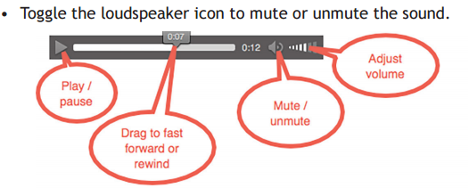

Quick Start Guide - Navigation Bar
Current question shows white background with triangle pointed down
As questions are answered, they will turn green with checkmark below
Any question marked for review will turn blue with flag below
Pages with audio tracks and/or images associated with questions (media) are indicated with an icon

Slide 16
Quick Start Guide
Flagging a Question – Mark for Review
Students can mark a question to review for later by clicking on the flag in the top right hand corner of the screen
In addition to turning blue in the navigation bar; questions marked for review will be marked on the ‘Review and End’ screen

Slide 17
Quick Start Guide
Help Button
When available, Help is accessible by clicking the question mark in the top right hand corner of the screen
Any available help will pop up in a white box next to question mark
Click blue ‘X’ to close help window

Slide 18
Quick Start Guide
Save as Draft
When available, ‘Save as Draft’ allows students to save test answers without submitting or completing the test
Allows students to return to the test to complete at another time
Would be applicable for students with approved accommodations to test over multiple test sessions or students still testing at the end of a school day
Still requires reactivation if test is not re-started within time limit

Slide 19
Quick Start Guide
Navigation Buttons
Buttons on bottom right hand corner of screen allow students to navigate to the next question, previous question, clear an answer or go to the Review and End screen
Students may navigate to any question from the current ‘test part’ to review, add or change answer choices at any time prior to submitting

Slide 20
Quick Start Guide
Questions with Passages
When questions include passages, the display will be a split screen with the passage on the left and the question on the right. In most cases, the entire passage and question will not fully appear and students will need to use the scroll bar on the right hand side of the passage or question.

Slide 21
Quick Start Guide
Questions with Passages
Students can toggle the view to show only the passage, only the questions, or both the passage and the questions by using the three buttons at the bottom of the screen

Slide 22
Quick Start Guide
Writing Responses and Save Button
On extended response questions, students will enter their response into a text box that has word processing tools. Included in the tool bar is an option to ‘Save’ the response which would prevent a student from losing their work due to a power or computer failure.
It is recommended students use the save button often to prevent potential loss of work.

Slide 23
Quick Start Guide
Ending a Test
Ending a test requires students to navigate through two screens after clicking ‘Review and End’
First screen provides a summary of questions for review and indicates whether each question was answered, unanswered or marked for review
Students should raise hand and show proctor this screen prior to clicking ‘End’

Slide 24
Quick Start Guide
Ending a Test
Ending a test requires students to navigate through two screens after clicking ‘Review and End’
Second screen prompts students to indicate they are sure they want to end and submit their test
After submitting test, students click ‘Sign Out’ to exit KITE
Proctors should verify students click ‘Yes’ on this screen to end the test after the review screen

Slide 25

Test Tools
The following Tools are available for students on some parts of the test
    Eraser – Allows students to remove highlighter and strikethrough effects
    Highlighter – Allows students to select and highlight text within a test question by dragging and dropping
    Magnification – Enables a student to enlarge the screen by clicking on a button to zoom in and zoom out
    Note – Original – Allows a student to make notes about a test question – not saved
    Pointer – Allows students to select items and click to answer question
    Search – Allows students to search for keywords or phrases within the question and answer choices displayed
    Strikethrough – Allows students to mar a line through a selected portion of text
    Tags – Allows a student to use labels within a reading passage to identify main idea, supporting details, key words, evidence, etc.

Slide 26
This is the end of the Presentation

